Slide 1
Amazon ML Challenge - Product Browse Node Classification
By Team ML05
Members:
Deborshi Deb
Avishek Paul
Ddhruv Arora
Kushagra Kapoor

Slide 2
Project Prerequisites
Below are the prerequisites for this project:
Python (3.7)
IDE – Jupyter Notebook (Kaggle with TPU v3-8)
Frameworks used:
NumPy
Pandas
Keras
TensorFlow (Keras uses TensorFlow in backend)
Matplotlib
Scikit – Learn
Plotly and Cufflinks

Slide 3
Dataset Used
Amazon catalog consists of billions of products that belong to thousands of browse nodes (each browse node represents a collection of items for sale). Browse nodes are used to help customer navigate through the website and classify products to product type groups. Hence, it is important to predict the node assignment at the time of listing of the product or when the browse node information is absent.
As part of this hackathon, we used product metadata to classify products into browse nodes with access to product title, description, bullet points etc. and labels for ~3MM products to train and test our submissions.
Data Description:
Key column - PRODUCT_ID
Input features - TITLE, DESCRIPTION, BULLET_POINTS, BRAND
Target column - BROWSE_NODE_ID
Train dataset size - 2,903,024
Number of classes in Train - 9,919
Overall Test dataset size - 110,775

Slide 4
Implementation
The process of making this project is divided into 3 parts, namely:
Loading the Data and performing Exploratory Data Analysis (EDA)
Pre-Processing the Data
Creating the Model and predicting Output.

Slide 5

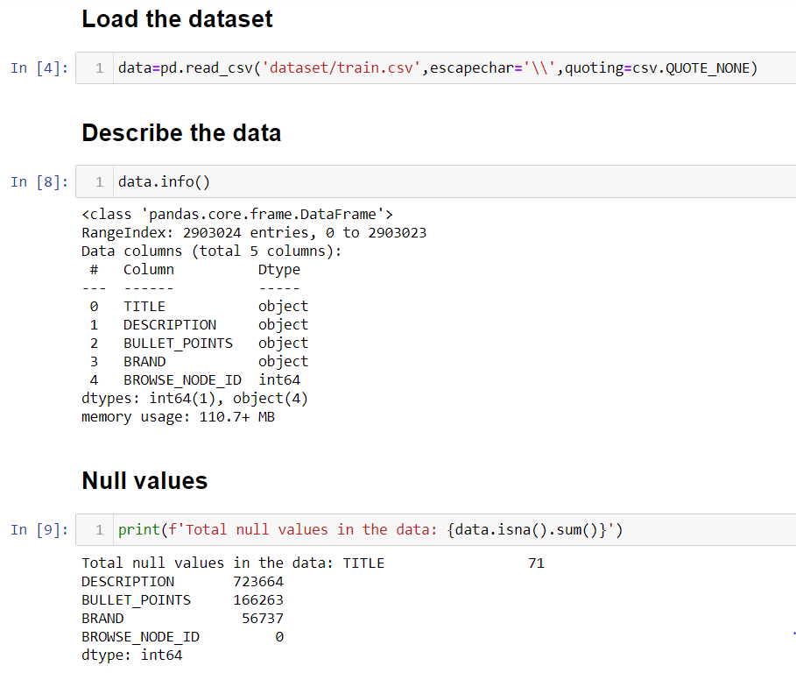
Loading the Data and Performing Exploratory Data Analysis (EDA)
We load the dataset into a dataframe. We see that most of the columns of the dataframe contain substantial amount of NULL values.

Slide 6
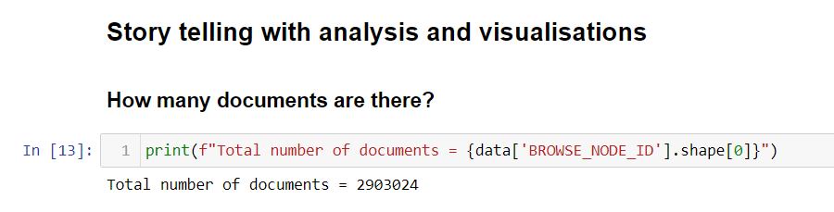
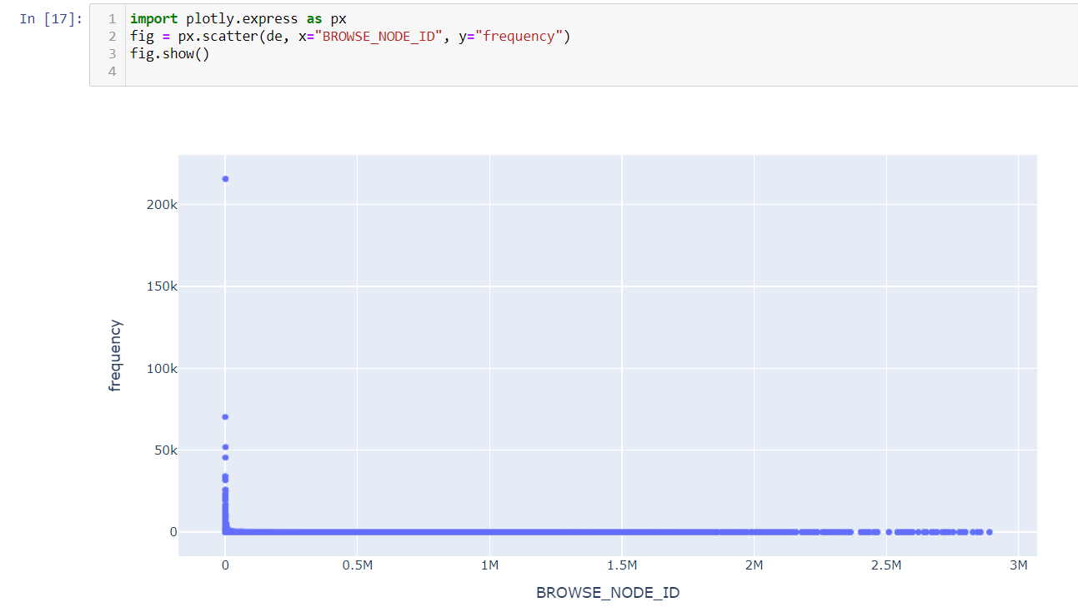

Slide 7
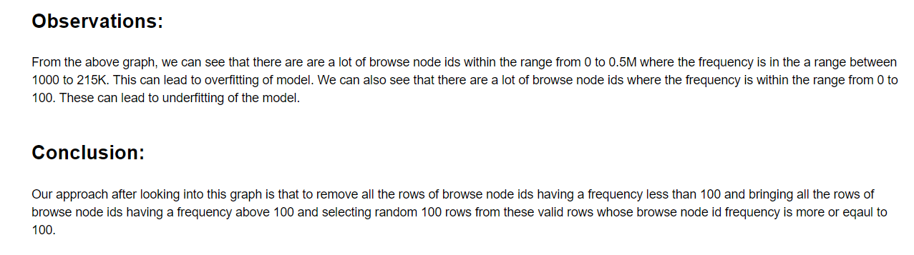

Slide 8
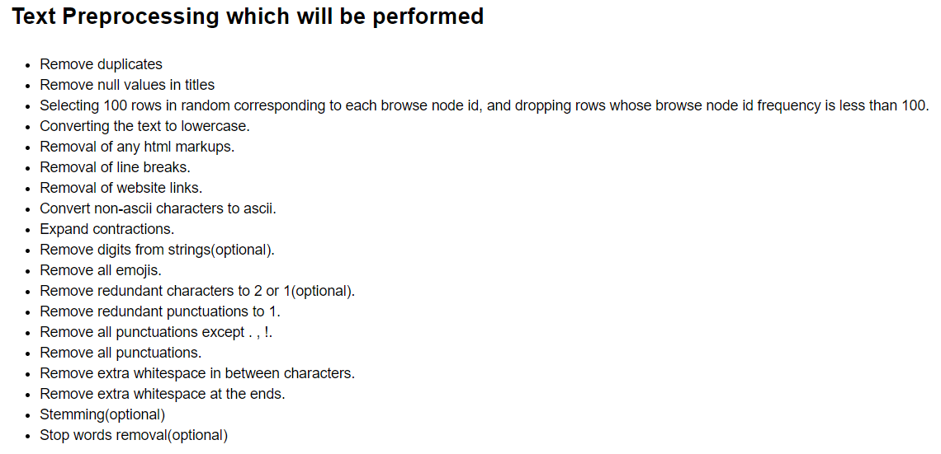
Pre-Processing the Data

Slide 9
Creating the Model and predicting Output.
Approach:
Our approach is based on by classifying the texts in title based on the browse ids and prepare a SVM model for it, followed by making a prediction using the SVM model on the test data.

Slide 10
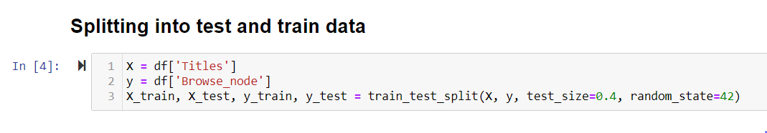
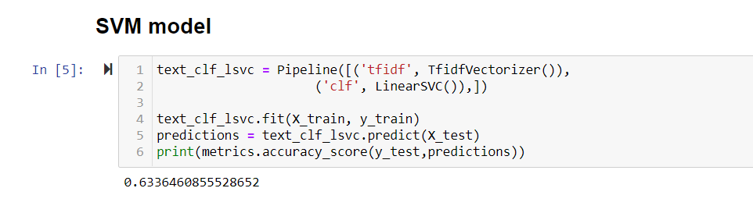
The model predicts with an accuracy of 63.36% which is quite good.

Slide 11
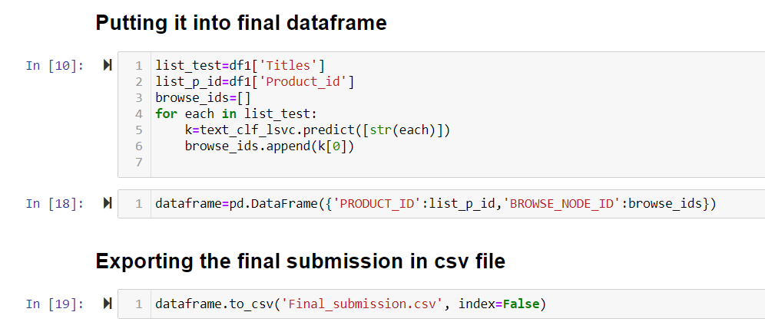

Slide 12
Conclusion
We have successfully developed a Browse Node ID prediction SVM model with an accuracy of 63.36%.

